Slide 1


Good evening! Please find a seat at a table and help yourself to lined paper and a pen/pencil. There is also one stapled handout between two ☺.
Notes:
This session is designed for schools new to the Mathematics Mastery (MM) approach, who may want to roll out aspects of MM across the school. This workshop focusses on developing success for all across all year groups. This underpins Mathematics Mastery’s core belief. This workshop should take approximately one hour to deliver.

Slide 2
Mathematics Mastery Workshop
Thursday 11th October 2018
Notes:
This session is designed for schools new to the Mathematics Mastery (MM) approach, who may want to roll out aspects of MM across the school. This workshop focusses on developing success for all across all year groups. This underpins Mathematics Mastery’s core belief. This workshop should take approximately one hour to deliver.

Slide 3
Aims
Understand the key principles of ‘mastery’
Explore what this looks like in practice
Develop and discuss ways of supporting your children at home
Notes:
Time: 1 minute
Purpose: To share the aims of the session
Facilitation: Share the aims of the session.
Resources: none

Slide 4
1. What is ‘Mathematics Mastery’?
Notes:
Discuss with your partner.

Slide 5
Mathematics Mastery vs ‘Maths Mastery’
Mathematics Mastery
Programme
Reception and Y1 (2018-19)
Gradual implementation
‘Maths Mastery’
General term
An approach to developing mastery for all
Notes:
Discuss with your partner.

Slide 6

What is “mastery?”
Notes:
Discuss with your partner.

Slide 7
What is mastery?
“In mathematics, you know you’ve mastered something when you can apply it to a totally new problem in an unfamiliar situation.”
Dr. Helen Drury,
Executive Director and founder of Mathematics Mastery
Notes:
Discuss with parents what this means. Can they think of examples outside of maths where this is true? (E.g. in learning to drive a car, you may feel you have mastered it when you can drive a different car, drive in snow and on ice, when you apply the skills of driving a car to driving a van etc.)

Slide 8
What is “mastery?”
Nothing to do with prior attainment (or “ability”):
Success for all
Positive attitudes towards maths
Richer, deeper understanding of concepts
‘Secure’ enough understanding that children can use and apply with confidence:
Calculate fluently
Solve problems
Reason confidently
Make connections
Notes:
Discuss with your partner.

Slide 9
What is “Mathematics Mastery?”
Mathematics Mastery is a not-for-profit organisation.
Vision
For every child to enjoy and succeed in mathematics, regardless of background.
Mission
To transform mathematics education in the UK. We work in partnership to empower and equip schools to deliver world-class mathematics teaching.
Notes:
Mastery is an often discussed term in education. Mathematics Mastery started in 2012 with 20 schools and has expanded to around 400 primary schools and 200 secondary schools in 2018. Our vision is that all children enjoy and succeed in maths, no matter what their starting points. We do this by giving schools the resources and training to better support their teachers to achieve this.

Slide 10
Curricular principles
Pupils are not going to be working through the curriculum more quickly, but going deeper into it. In Year 1 it is imperative that pupils have full understanding of number sense, number bonds and place value, as all number work in maths builds on what is taught in this year group.

Slide 11
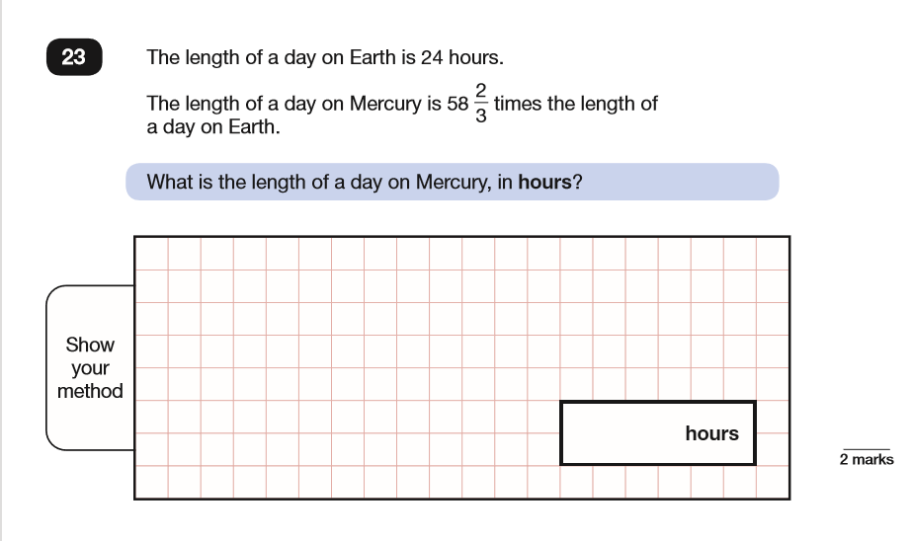
Notes:
Suggested timings: 3-4 minutes
Purpose: To explain the Dimensions of Depth.
Facilitation: Explain to participants that these Dimensions of Depth have not been picked arbitrarily but because, in order to solve problems (real-life or otherwise) effectively we need to engage each of these three principles. These are taken from Helen Drury’s book ‘Mastering Mathematics’ and were developed as a way of incorporating the answers to two key questions:
What is standing in the way of ‘low attainers’ succeeding in maths/succeeding at problem solving?
What are the mathematical working practices that high achieving mathematicians could do with strengthening further to be more adept at solving more sophisticated problems?
The research identified the following barriers:
1. Struggling to verbalise their thoughts on maths (Language & communication) Pupils deepen their understanding by explaining, justifying and by creating problems of their own.
2. Not being able to make sense of mathematical concepts in a meaningful way (Conceptual understanding). Conceptual Understanding is about developing meaning through the use of multiple representations. Those representations include concrete objects, images, the abstract symbols including numerals that we use to record maths efficiently and, very importantly, the words and phrases in our mathematical vocabulary.
3. Finding ‘thinking mathematically’ challenging (Mathematical thinking). Mathematical thinking relies on deep conceptual understanding and the ability to speak precisely using mathematical language in order to identify patterns, sort and compare and to make conjectures and generalisations about the maths being explored.
Whether struggling or excelling, all learners benefit from deepening their mathematical understanding through these three dimensions and they should be present in every single lesson.
Identify that the central triangle has not been referred to and link to the following slide.
Resources: none

Slide 12
Dimensions of Depth
Conceptual understanding
Mathematical problem solving
Mathematical thinking
Language and communication
Drury (2014)
Notes:
Suggested timings: 3-4 minutes
Purpose: To explain the Dimensions of Depth.
Facilitation: Explain to participants that these Dimensions of Depth have not been picked arbitrarily but because, in order to solve problems (real-life or otherwise) effectively we need to engage each of these three principles. These are taken from Helen Drury’s book ‘Mastering Mathematics’ and were developed as a way of incorporating the answers to two key questions:
What is standing in the way of ‘low attainers’ succeeding in maths/succeeding at problem solving?
What are the mathematical working practices that high achieving mathematicians could do with strengthening further to be more adept at solving more sophisticated problems?
The research identified the following barriers:
1. Struggling to verbalise their thoughts on maths (Language & communication) Pupils deepen their understanding by explaining, justifying and by creating problems of their own.
2. Not being able to make sense of mathematical concepts in a meaningful way (Conceptual understanding). Conceptual Understanding is about developing meaning through the use of multiple representations. Those representations include concrete objects, images, the abstract symbols including numerals that we use to record maths efficiently and, very importantly, the words and phrases in our mathematical vocabulary.
3. Finding ‘thinking mathematically’ challenging (Mathematical thinking). Mathematical thinking relies on deep conceptual understanding and the ability to speak precisely using mathematical language in order to identify patterns, sort and compare and to make conjectures and generalisations about the maths being explored.
Whether struggling or excelling, all learners benefit from deepening their mathematical understanding through these three dimensions and they should be present in every single lesson.
Identify that the central triangle has not been referred to and link to the following slide.
Resources: none

Slide 13
Language & Communication
Conceptual understanding
Mathematical problem solving
Language and communication
Pupils deepen their understanding by explaining, creating problems, justifying and proving using mathematical language. This acts as a scaffold for their thinking and deepening their understanding further.
Mathematical thinking
Language and communication
Notes:
Suggested timings: 2-3 minutes
Purpose: To explore Language and Communication
Facilitation: Explain that the Dimensions of Depth are deeply intertwined and that it is somewhat artificial to separate them. However, in order to think about the strategies we can use to support pupils, it helps to talk about each one separately and we’re going to start with language for two reasons:
It plays a large role in both conceptual understanding and the ability to think mathematically, as well as being a key feature of the problem solving process itself.
It is important that this aspect is focused on early when the programme is implemented.
We want to support pupils in their development of mathematical language because it is what allows them to reason.
Resources: none

Slide 14
Mathematical language
Mathematics Mastery lessons provide opportunities for pupils to communicate and develop mathematical language through:
Sharing essential vocabulary at the beginning of every lesson and insisting on its use throughout
Modelling clear sentence structures using mathematical language
Paired language development activities, known as Talk Tasks.
Plenaries which give a further opportunity to assess understanding through pupil explanations.

Slide 15
Variety of vocabulary
Equals/is equal to/makes
7 + 4 = 11
35 + 9 = 35 + 10 – 1
14 + 27 = 26 + ___
11 = 7 + 4
How can you solve this?
Equals/is equal to/makes
Notes:
Suggested timings: 2-3 minutes
Purpose: To focus on specific key vocabulary
Facilitation: Invite teachers to ‘read’ each sentence and use the suggested vocabulary to describe the symbol ‘=’. Allow a minute for discussion and then feed back. If not drawn out in discussion, highlight the following points:
‘makes’ is only really applicable to the first example.
Complete first animation – would ‘makes’ work now? Why not? Emphasise that makes only works in one direction.
Equals feels awkward for all the other examples.
Point out that it’s ‘is equal to’ that works best for all of the examples given because it establishes that equivalence goes both ways.
Pose this last calculation (animation 2) and allow time for discussion as to how it might be solved using the language of equality. It is not necessary to solve the calculation: noticing that 26 is one less than 27 leads you to conclude that the missing value must be one more than 14 and the animated bar model supports the explanation of this. Developing pupils understanding around the meaning of the symbol ‘=’ will/should encourage pupils to interpret the calculation and then decide the most efficient way to solve it.
Resources: none

Slide 16
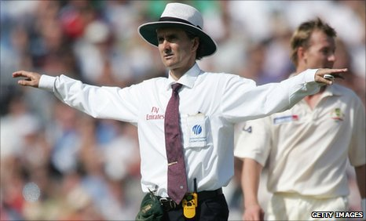
‘Full’ sentence expectations
HOWZAT?!!
Can you say that in a full sentence, please?
To make ten, I need to partition __ into __ and __.
The number bond I am using is…
Notes:
Suggested timings: 2-3 minutes
Purpose: To focus on full sentence expectations
Facilitation: Explain that adults must model and pupils must understand an expectation of always using the relevant correct mathematical language in sentences i.e. the key vocabulary for that lesson. Non-sentence answers often avoid using key vocabulary, which is then only heard when used by the teacher. Key vocabulary used in sentences allows understanding in context and pupils using or just hearing this consistently will deepen their understanding. Best practice includes modelling and displaying sentence stems for new or tricky language. An example is provided.
The image is a prompt for teachers to consider how they might use a non-verbal signal to prompt pupils to respond in a full sentence.
Resources: none

Slide 17

Big Pictures: Language and Communication
Big Pictures
Opportunities to relate maths to ‘real’ life applications
Opportunities for pupils to make connections
Opportunities to promote and develop pupil reasoning
Notes:
Suggested timings: 2-3 minutes
Purpose: To introduce the Big Pictures
Facilitation: Explain that Big Pictures are provided as part of the materials. Share the opportunities these provide by allowing participants time to read the bullet points on the slide. These are available on a generic page on the toolkit and can be shared with all teachers in the school. These can be a useful stimulus for promoting mathematical language and providing a context for the maths explored.
The Big Pictures for each year group are themed:
Reception: Nursery Rhymes
Year 1: Fairy Tales
Year 2: Occupations
Year 3: Landmarks around the UK
Year 4: Countries
Year 5: The Olympics
Year 6: Space
Resources: You may wish to share the location of the Big Pictures: https://toolkit.mathematicsmastery.org/classroom-planning/printable-resources

Slide 18
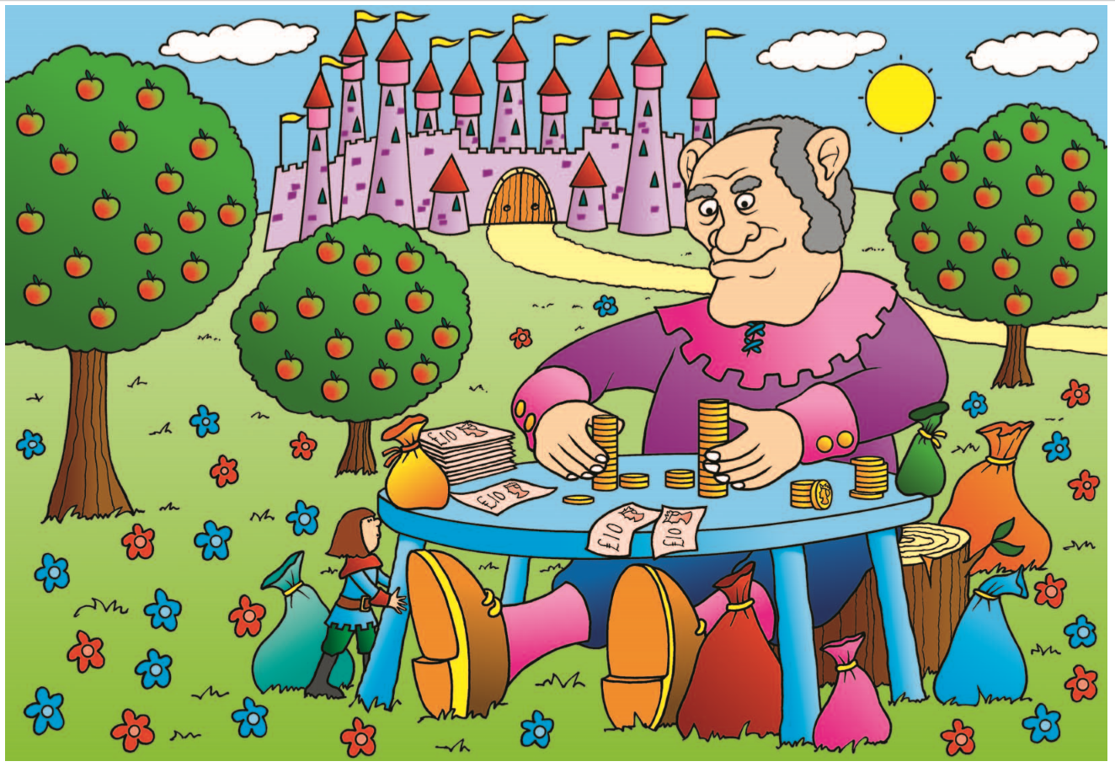
Big Pictures: Language and Communication
Notes:
Suggested timings: 2-3 minutes
Purpose: To introduce the Big Pictures
Facilitation: Explain that Big Pictures are provided as part of the materials. Share the opportunities these provide by allowing participants time to read the bullet points on the slide. These are available on a generic page on the toolkit and can be shared with all teachers in the school. These can be a useful stimulus for promoting mathematical language and providing a context for the maths explored.
The Big Pictures for each year group are themed:
Reception: Nursery Rhymes
Year 1: Fairy Tales
Year 2: Occupations
Year 3: Landmarks around the UK
Year 4: Countries
Year 5: The Olympics
Year 6: Space
Resources: You may wish to share the location of the Big Pictures: https://toolkit.mathematicsmastery.org/classroom-planning/printable-resources

Slide 19
Reasoning!
I used a circle because it is curved. A wheel is curved like a cylinder so that it can roll.
I have used three circles for the wheels in the picture.
The circle has a curved side.
This is a circle.
Justifying
Re-telling
Describing
Naming
Notes:
Suggested timings: 2-3minutes
Purpose: To understand the model for developing verbal reasoning
Facilitation: Ask participants to imagine a child has created the vehicle from shapes. Questions can be used to elicit different levels of verbal reasoning. Highlight:
Naming – focus on the object (animation 1)
Describing – talking about the object (animation 2)
Re-telling – focus on the context (animation 3)
Justifying – relationship between object and context (animation 4)
Explain that in order for pupils to have opportunities to use higher order verbal reasoning, teachers need to consider questioning to ensure opportunities arise.
Resources: none
Note – this would be an appropriate point to break this workshop into two sessions.

Slide 20
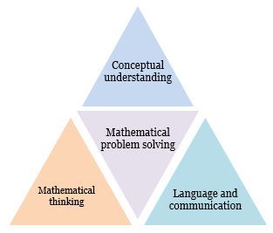
Conceptual understanding
Conceptual understanding
Pupils deepen their understanding by representing concepts using objects and pictures and, more abstractly, with words and symbols. They make connections between different representations and consider what different representations stress and ignore.
Notes:
Suggested timings: 1-2 minutes
Purpose: To understand conceptual understanding.
Facilitation: Turn attention towards the next Dimension of Depth and share what is meant by Conceptual Understanding. Allow participants to read the definition. In order to develop a conceptual understanding we believe pupils should: Make connections between previous learning and their current thinking, deepen understanding through the application of a concept, research and seek information.
Resources: none

Slide 21
Activity
14
Notes:
Activity 3
Suggested timings: 3-5 minutes
Purpose: To explore conceptual understanding.
Facilitation: To get participants to think flexibly about a number using concrete, pictorial and abstract materials, allow a few minutes to represent the number 14 in as many ways as possible. Encourage teachers to show a depth of understanding for 14 and perhaps to use representations they are less familiar with. The following slides give examples to facilitate discussion.
Resources: a range of manipulatives, pens and paper

Slide 22
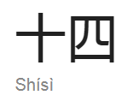
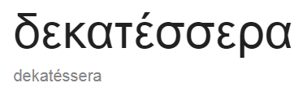
Abstract representations
14
fourteen
Four more than ten
XIV
Symbolic stage
Numbers, letters and symbols
Most formal stage of mathematical understanding
Efficient way of representing the maths
10 + 4
Notes:
Suggested timings: 2-3minutes
Purpose: To understand what is meant by abstract representations
Facilitation: Invite participants to share abstract representations; prompt by showing the first animation and asking if anyone wrote the word ‘fourteen’. Animations 2-6 show further abstract examples. Dekatessera is greek and Shisi is Chinese. Interestingly, for the Greek word, it starts with deka which means 10 and followed by tessera which means four. In English, the teen numbers are said contradictory to the way they are written and are quite an abstract form to understand.
Define abstract by reading the bullet points (animation 7). Explain that in order to attach meaning to the abstract representations, pupils must experience concrete and pictorial representations.
Resources: examples created in Activity 3

Slide 23
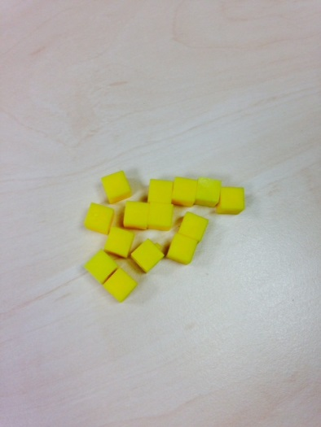
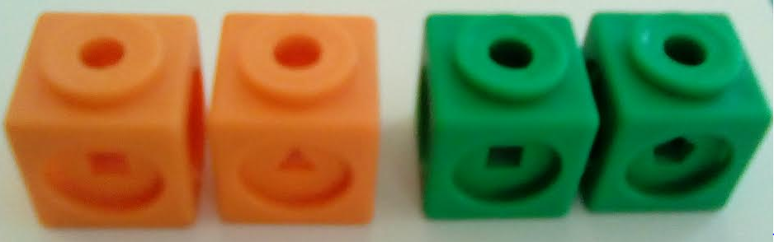
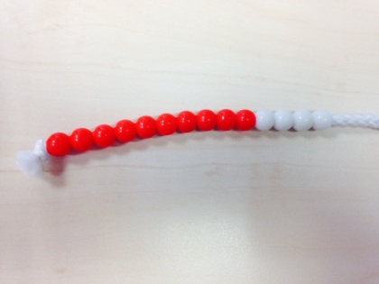
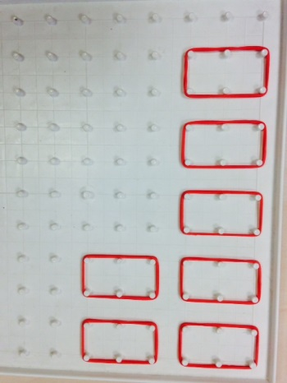
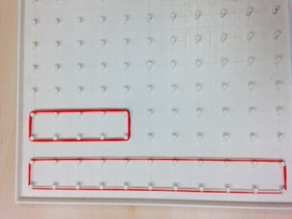
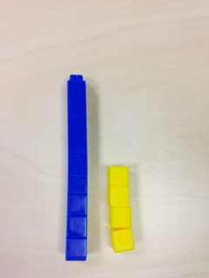
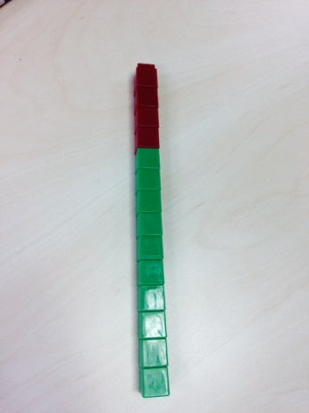
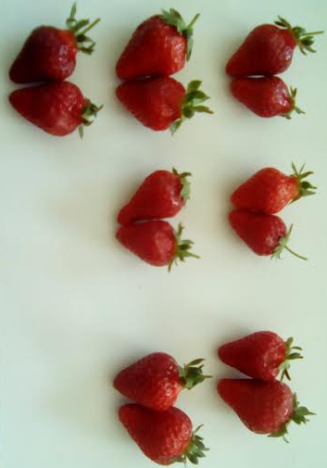

Concrete representations
Notes:
Suggested timings: 2-3 minutes
Purpose: To understand what is meant by concrete representations
Facilitation: Share any concrete representations created during the activity. Explain that concrete manipulatives refers to real objects or items that can be picked up and handled/manipulated. Share the examples on the slide emphasising that real objects or more abstract cubes and counters can be used. Ensure teachers understand that the concrete representations are an important way of making a concept meaningful – not just a ‘way to do the maths’. Emphasise the expectation that manipulatives are to be accessible to ALL pupils in ALL lessons.
Focus on the orange and green cubes (animation 9) – can anyone explain how this could represent 14? One possibility is that the orange cubes have a value of 2 and the green have a value of 5. Discuss other possibilities, recognising that decimal or fractions could be possibilities.
Resources: Examples created in activity 3

Slide 24
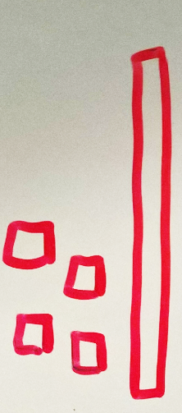
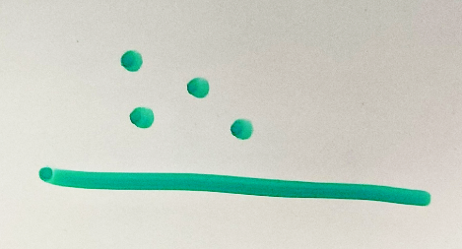


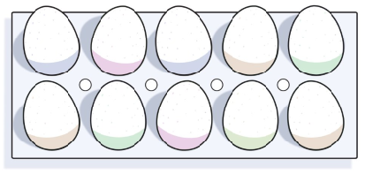
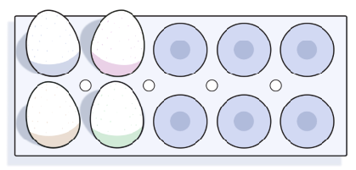
Pictorial representations
Images of actual concrete manipulatives
Tallies, dots, circles
Drawing
Jottings
Bar models
Number lines (mixture of pictorial and abstract)
+2
+4
14
8
10
14
11
3
Notes:
Suggested timings: 2-3 minutes
Purpose: To understand what is meant by pictorial representations
Facilitation: Share any pictorial representations created by teachers. Explain what is meant by pictorial representations using the bullet points, animated to appear alongside supporting images. Draw attention to the number line (animation 6), which is a combination of pictorial and abstract.
Resources: examples created in activity 3

Slide 25
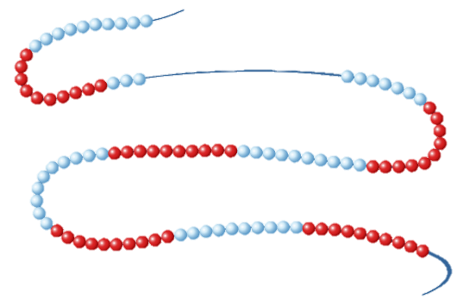
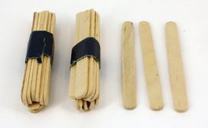






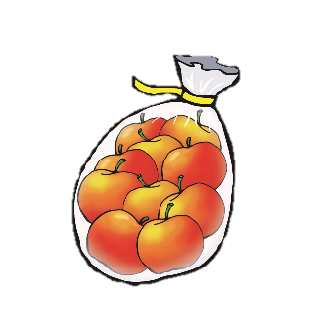



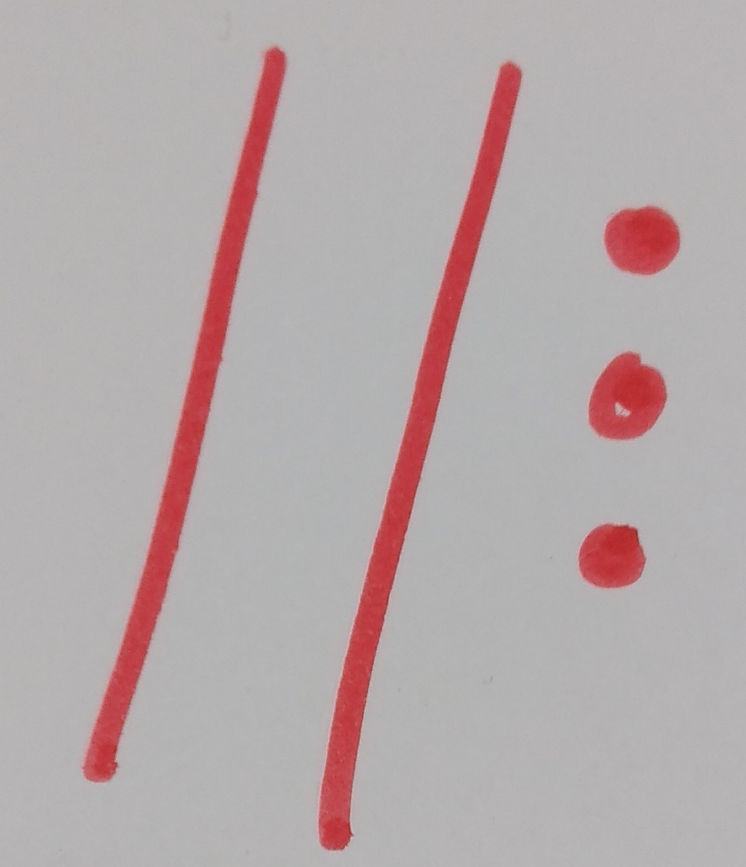
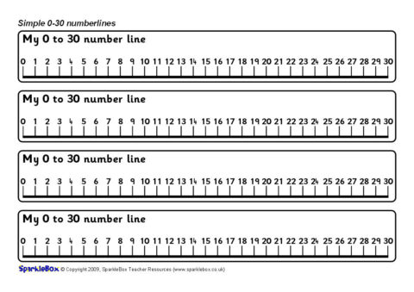
Multiple representations
Concrete
The DOING
Abstract
The SYMBOLIC
Pictorial
The SEEING
Tens | Ones
2 | 3
Demonstrating depth
/‘twɛnti ˈθri/
23
twenty three
Notes:
Suggested timings: 2-3 minutes
Purpose: To understand the CPA approach
Facilitation: Introduce participants to the concrete pictorial abstract (CPA approach). The concrete pictorial abstract approach is not a new concept: it is based on research by Jerome Bruner, a psychologist who worked extensively in the field of educational research, in 1960s. He summarised the process of learning by saying that for the learning of anything abstract, it must be experienced first, and by experienced, we mean the manipulation of real objects and seeing how they can then be represented pictorially, before the symbols are introduced. Initially Bruner identified this as a linear process starting with the concrete.
Run animation. Emphasise that concrete representations (animations 1 – 4) can be represented by other abstract /objects that can be manipulated, e.g. counters/cubes. Make it clear to participants that links between representations should be made explicit and for pupils to develop deep understanding of a concept, they should move between representations, and understand the different elements that they emphasise or ignore about the concept. They can also be used to scaffold explanations and to make pupils’ explanations clearer to others.
Resources: none

Slide 26
Mathematical Thinking
Mathematical thinking
Pupils deepen their understanding by giving an example, by sorting or comparing, or by looking for patterns and rules in the representations they are exploring problems with.
Conceptual understanding
Mathematical problem solving
Mathematical thinking
Language and communication
Notes:
Suggested timings: 1 minute
Purpose: Introduce mathematical thinking
Facilitation: Share the final Dimension of Depth and define what is meant by Mathematical thinking. Allow teachers time to read the definition.
Resources: none

Slide 27
Mathematical Thinking
“Mathematics can be terrific fun; knowing that you can enjoy it is psychologically and intellectually empowering.” (Watson, 2006)
We believe that pupils should:
Explore, wonder, question and conjecture
Compare, classify, sort
Experiment, play with possibilities, modify an aspect and see what happens
Make theories and predictions and act purposefully to see what happens, generalise.
Notes:
Suggested timings: 2-3 minutes
Purpose: Consider the definition of mathematical thinking
Facilitation: Ask participants to read the quote and highlight that we want children to think like mathematicians. Not just DO maths… Share the bullet points (animated) which explain what is involved in promoting and engaging in mathematical thinking. To do this, teachers will be completing a short task.
Resources: none

Slide 28
Arithmagons
Choose a different number for each
Write the sum in
Make at least three examples
2 3
5 6
7 8 9
Notes:
Activity 5
Suggested timings: 3-4 minutes
Purpose: Engage in mathematical thinking.
Facilitation: Explain that the participants will engage in mathematical thinking through this task at their own level and at the end they will be asked to unpick the process and consider how mathematical thinking was promoted with the aim of helping them consider how to do this in their classroom. This task can be adapted and used in classes R-Y6 however that is not the focus of the activity here.
Share the instructions for creating an arithmagon and model creating one. They can place the numbers 1-9 in any of the vertices in the arithmagon but they can only use each number once per arithmagon (in the red vertices). They must then sum two of the vertices and write the sum in the connected grey rectangle (the totals here may make 2-9 – that is fine). Ask participants to make three different examples and share them with their partner.
Resources: pens and paper

Slide 29
Complete these:
4
8
7
8
11
7
6
9
12
Notes:
Suggested timings: 3-4 minutes
Purpose: Engage in mathematical thinking.
Facilitation: Now teachers have created some examples of their own, ask them to complete these arithmagons. The sum of the numbers are given and they must work out the values at the vertices. The completed arithmagons are shown on the following slide. If some teachers are struggling to get started a prompt can include: all of these examples use the number three.
Resources: pens and paper

Slide 30
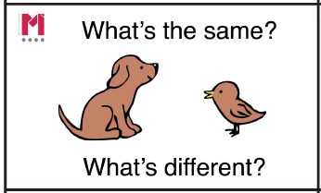
Compare these:
3
3
7
8
4
8
4
5
3
1
5
9
11
7
6
8
4
12
Notes:
Suggested timings: 3-4 minutes
Purpose: Engage in mathematical thinking.
Facilitation: Participants are to describe as many similarities and differences as they can. Use the discussion to draw out the words consecutive, even, odd. Encourage participants to use these words in full sentences and ensure all understand the definitions.
These are some of the similarities that teachers may draw out:
All the arithmagons have the number 3 at the top. Is this always the case?
In the first arithamgon on the slide, the numbers in the vertices are consecutive and so are the sums. Does this always happen? I wonder…
The numbers in the arithmagon on the top right are all odd. The sums are all even. Does this always happen? Prove it to me.
The sum of all the numbers in the vertices is always half the sum of the numbers in the grey rectangles. Does this always happen?
Resources: none

Slide 31
Dimensions of Depth
“Teaching is for learning;
learning is for understanding;
understanding is for reasoning and applying and, ultimately problem solving.”
Conceptual understanding
Mathematical problem solving
Mathematical thinking
Language and communication
Success for all
Ministry of Education, Singapore (2012), p.21
Notes:
Suggested timings: 1-2 minutes
Purpose: Summarise the session: Dimensions of Depth
Facilitation: Review everything covered in the session by returning to an earlier quote.
Highlight that there is a great deal of interplay between these Dimensions of Depth – all three are closely interlinked and not easily separated but we make the distinctions so that it is easier to identify strategies to include in our teaching that ensure all three Dimensions of Depth are well developed. Ensure teachers are aware of the underlying belief that every child can succeed and this underpins the three Dimensions of Depth.
Resources: none

Slide 32
2. What does this look like in the classroom?
Notes:
Discuss with your partner.

Slide 33
The six-part lesson structure
Talk Task
or
Let’s Explore
Plenary
Do Now
New Learning
Develop Learning
Independent Task
Notes:
Time: 1 minute
Purpose: To share the six-part lesson structure
Facilitation: Allow participants to view the six-part lesson structure. Explain that the workshop will develop their understanding of the parts of the lesson. You may want to take this opportunity to allow teachers to jot down any initial question they may have about the structure.
Resources: none

Slide 34
Let’s see it in action!
https://toolkit.mathematicsmastery.org/community/videos/mm-lesson-videos
Can you spot any of the dimensions of depth in the video?

Slide 35
3. How can you help your children at home?
Notes:
Discuss with your partner.

Slide 36
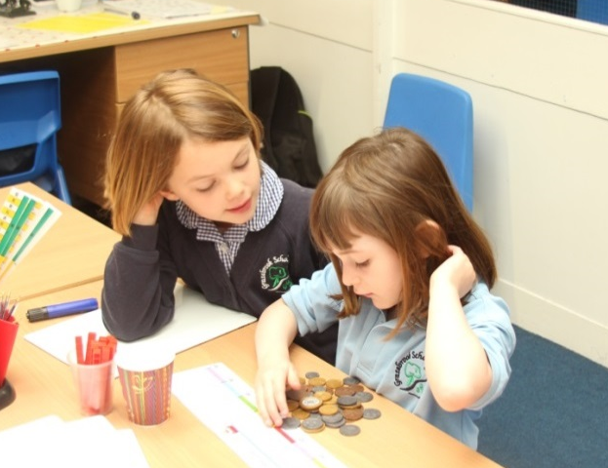
Success for all
We believe that everyone can get better at maths…when they put in the effort and work at it.
Notes:
Time: 1 minute
Purpose: Recognising that all pupils can achieve.
Facilitation: Share the statement and explain that this links closely to the Mathematics Mastery vision of all pupils enjoying and succeeding in mathematics, regardless of background. We acknowledge that every pupil will have a different starting point but what’s important is that they can improve from that starting point.
Resources: none

Slide 37





Negative perceptions of maths
I can’t do maths
I hated maths at school
I was never any good at maths
…it’s ok to be rubbish at maths
…maths isn’t important
Self-fulfilling prophecy
There is no maths gene
Develop perseverance and resilience and good ‘habits of mind’.
Notes:
Suggested timing: 2-3 minutes
Purpose: Highlight negative perceptions of maths
Facilitation: Make links to previous slide, recognising that while your teachers may instil the belief from the previous slide, pupils will undoubtedly hear some/a lot of negative perceptions around maths outside of the classroom. People can often be very quick to proclaim that they are not good at maths, and this is an accepted statement- for example when dealing with the bill at a restaurant, people will say ‘I can’t do maths’, but you’ll rarely hear ‘I can’t read’ or ‘I can’t write’.
Animation 1: The more pupils hear this negative talk the more it will become a self-fulfilling prophecy as pupils will assume that it is acceptable to not be very good at maths.
Animation 2: Every adult within school needs to reiterate that there is no maths gene – their mathematical attainment is not dictated by how their parents did at school or how they feel now about maths.
Animation 3: Pupils need to be resilient and understand that success in maths comes from effort.
Resources: none

Slide 38
How can we overcome negative perceptions of maths?
I need to believe in myself
I need to be viewed as able
Intelligence can grow
Intelligence is fixed
When the going gets tough ... dig in and persist
When the going gets tough ... I get found out
Effort leads to success
Ability leads to success
Portray challenges, effort, and mistakes as highly valued for all pupils.
Praise and feedback on the process.
From Dweck C., Mindsets and Math/Science achievement, Stanford University, 2008
Notes:
Suggested timing: 2-3 minutes
Purpose: Inform participants of what they can do to encourage positive attitudes about maths
Facilitation: Explain that one of the most effective ways in which additional adults can support positive mindsets is to have a growth mindset themselves: believing that ability can improve with effort is fundamental and supports pupils Personal, Social and Emotional Development, one of the Prime areas in the EYFS as well as linking to several of the CoEL in the EYFS; Active Learning and Playing and Exploring. Use the first 8 animations to show some suggestions.
The bullet points (animated) are covered in further detail in the following slides.
Animate the first bullet point. Explain:
We need to encourage challenge as a good thing and that it is about the effort that we put in. Hard work can be a good thing: we may face mistakes along the way but we can learn from them.
Emphasise that this needs to apply to all pupils in the class, including higher attaining pupils who very often, may not highly value mistakes and challenge. Very often high attainers have made few mistakes or got things wrong. Therefore when they do make a mistake, they can often shy away from what they were doing but they feel they are not ‘succeeding’.
Animate the second bullet point. Explain:
Process praise/feedback includes feedback about strategies, effort, perseverance, challenge-seeking, improvement, etc. This is as opposed to person praise/feedback, which refers to the intelligence or talents of the student, or outcome praise/feedback, which puts the focus on the final product
Resources: None

Slide 39



Types of praise
Well done on your maths test, you have learnt from the feedback I gave you last week and have improved.
I am amazed that you have finished the task already - you are such a fast worker!
I am impressed by how hard you have tried to work this out.
I like the way you tried to work that out. Your answer is very close – try again!
You scored 90% on your exam which is an ‘A’ grade! You are excellent at Maths!
Great! You persevered and did well in your subtracting equations!
I enjoyed marking your work. You got all the questions right! You are destined to be a mathematician when you grow up!
Notes:
Time: 2-3 minutes
Purpose: To reflect on types of praise.
Facilitation: Share the examples of person praise (blue boxes). Explain that although these types of praise comments are positive and common in the classroom, they do encourage a fixed mindset in mathematics. The praise given to pupils in class can impact on their own belief about their own ‘ability’ to do maths. If teachers are consistently praising the person and using words like, ‘clever’, ‘quickest’, ‘smart’, etc. then pupils are picking up that they are either clever or they’re not, or they need to be fast at maths to get praise. Invite participants to share further examples.
Share the examples of process praise (pink) and invite participants to notice that these statements focus on effort or process. Strategies for developing this in the classroom include:
Instead of praising pupils for being clever, focus on praising effort and particular strategies a pupil has used to tackle a problem.
When giving pupils feedback about their work, focus mainly on comments that emphasise their effort, dedication and how well they have applied themselves to the task rather than their achievement in terms of what grade or level they will be awarded.
The actual ‘learning’ of pupils should be the most important aspect of the classroom rather than placing too much emphasis on the grades or levels pupils have achieved.
Further examples of constructive praise from Willingham can be found here: https://www.aft.org/periodical/american-educator/winter-2005-2006/examples-constructive-praise-and-encouraging
Invite participants to share their own examples.
Resources: none

Slide 40

What is mindset?
Mindset is an idea developed by Dr. Carol Dweck.
A set of beliefs that determine somebody’s behaviour and outlook in life.
Two types of mindset:
A fixed mindset
A growth mindset
Notes:
Time: 1-2 minutes
Purpose: To discuss what mindset is.
Facilitation: Mindset is an idea developed by Dr Carol Dweck, a world-renowned psychologist, after decades of research on achievement and success. Participants may have an understanding of this. Ensure connection is made between mindset and success for all – fostering the right mindset can support all pupils in succeeding, and this mindset applies to adults working with pupils as much as the pupils themselves.
Mindset can be defined as a set of beliefs that determine somebody’s behaviour and outlook in life. In her work she describes the idea of there being two types of mindset – a fixed mindset and a growth mindset. These are explained on the following slides.
Resources: none

Slide 41
A fixed mindset
Ability and intelligence are innate and cannot be changed.
Tend to give up easily with tasks and avoid challenges
Feel threatened by the success of others.
Ignore constructive criticism.
Notes:
Time: 2-3 minutes
Purpose: To explore the terminology of a fixed mindset.
Facilitation: Animation 1: A fixed mindset can be described as someone who believes that ability and intelligence are things that are innate, that you are born with them. They believe that natural talent alone creates success and one does not need to put much effort into achieving things they are naturally good at. There is also the belief that intelligence and ability cannot be changed- they cannot be developed over time as they are fixed traits. Link this idea to those of the negative perceptions of mathematics – those with a fixed mindset are more likely to accept that they are good or bad at maths because of their parents.
Animation 2: People with a fixed mindset tend to give up easily with tasks as they get upset by mistakes and are afraid of challenges. Link this to the emphasis of challenges and mistakes as being positive from earlier.
Animation 3: They feel threatened by the success of others as they worry that their fixed intelligence and ability will not measure up to that of others.
Animation 4: Constructive criticism is usually ignored due to their belief that they cannot further develop – their abilities and intelligence are carved in stone from birth.
Resources: none

Slide 42
A growth mindset
Intelligence can be developed over time through effort, dedication and hard work.
Persevere with tasks and enjoy challenges.
Setbacks and criticism are lessons to be learnt from.
Inspired by and learn from the success of others.
Notes:
Time: 2-3 minutes
Purpose: To explore growth mindset
Facilitation: Animation 1: In contrast, a person with a growth mindset believes intelligence and ability can be developed over time through effort, dedication and hard work. They think that intelligence and ability are not fixed traits – they can definitely be changed and developed over time.
Animation 2: They tend to persevere with tasks and enjoy challenges due to the belief that effort needs to be expended to learn.
Animation 3: Setbacks and criticism are viewed as lessons to be learnt from on the path of achieving mastery.
Animation 4: People with a growth mindset are inspired by and learn from the success of others believing that they too can be successful if they apply effort and hard work. Constructive criticism is very much welcomed and acted upon.
Resources: none

Slide 43
Reflection - Success for all
A growth mindset can be promoted by:
modelling positive attitudes and language towards learning
celebrating mistakes, challenges and effort
reinforcing that intelligence is not ‘fixed’!
Notes:
Time: 2-3 minutes
Purpose: To summarise…
Facilitation: Participants should recognise that belief that all pupils can succeed in mathematics, using process praise, developing challenge and building positive perceptions of mathematics can lead all pupils to a more growth mindset attitude. This attitude enables pupils to see that effort, resilience and perseverance can all lead to achievement in mathematics. Having a growth mindset as a teacher and a pupil is more beneficial than having a fixed mindset. A growth mindset can be taught and allows pupils to embrace learning and growth, achieve to their potential and understand the role of effort in creating talent. Challenges and setbacks are also not detrimental to pupils’ confidence and effectiveness but are viewed as a tool for learning and developing skills.
Resources: none

Slide 44
How can I become involved?
Talk to your child about their learning and what they learned in their maths lessons each day.
Discuss numbers all around you: door numbers, bus numbers etc.
Encourage your child to predict what number will come next in a sequence of door numbers – are they odd or even?
Cooking and shopping with your child, getting them to weigh ingredients, using language such as “more” and “less/fewer”.

Slide 45
How can I become involved?
See the handout for lots more ideas about how to help your child achieve mastery!
See school website for this great document from MM: ‘20 number games to play in Year 1’
This presentation and handouts will be on the website for you to read and download ☺

Slide 46

Questions/comments/feedback?
Notes:
Suggested timing: 2-3 minutes
Purpose: To action plan
Facilitation: Conclude the workshop. Get participants to reflect on what they have learnt and write down their first three steps for implementing Maths Meetings. Take some feedback on action points. Draw teachers’ attention to the videos on the toolkit exemplifying good practice in other year groups.
Resources: none

